Slide 1
Abstract interpretation for the working programmer Lezione 1 – I Fondamentali
Francesco Logozzo
Microsoft Research
Redmond, WA, USA

Slide 2
Demo!

Slide 3
In these 3 lectures
How to build a real-life static analyzer
Research
Engineering trade-offs
Experience
Available for download:
http://msdn.microsoft.com/en-us/devlabs/dd491992.aspx
How to optimize JavaScript performances

Slide 4
Program verification
“The program does not go wrong”
What does it means?
It does not crash
Division by zero
Dereference of null (or 0 or nil)
No exception is thrown
…
It meets its specification
Specification???
What’s that?

Slide 5

Verification 101

Slide 6
Specification
Informally: “What the program should do”
“It should sort all the elements of the array”
Computers do not like English
(or Italian for what it matters ;-)
Which formal language?
How close to the computer?
How close to the human?
How close to the programmer?
How close to the verification tool?

Slide 7
A plethora of specification lang.
Implementation
Temporal Logic?
Z (B) notation?
UML?
TLA+ ?
Abstract state machines (ASM)?
JML? Code Contracts?
SAL?
…
Many many
...

Slide 8
The programmer…
Only limit imagination…
… and the programmer
The final user of all our tools
Specification must be
Programmer friendly!
Tool friendly!
The programmer will use your language only if she has advantage from it

Slide 9
Real world: SAL
(SAL = Simple Annotation Language)
Windows API annotation
Easy to understand (for a C programmer)
Mainly buffer annotations
void fill_string(
__out_ecount(cchBuf) TCHAR* buf,
size_t cchBuf,
char ch) {
for (size_t i = 0; i < cchBuf; i++) {
buf[i] = ch;
}
}

Slide 10


SAL
Compilation time analysis
Visual C++ /analyze switch
Early bug detection
Better code documentation
MSDN (Microsoft Developer network)
Programmers willing to add them ☺
Why?
Because they have great bang for bucks
Drawbacks?
Limited extensibility (expressivity)

Slide 11
Potato
Specification
The program behavior is included in the behaviors admissible from the specification:
Program is correct ☺
Program

Slide 12
Potato
Specification
The program behavior is not included in the behaviors admissible from the specification:
Program is incorrect ☹
(Some behavior may not meet the specification)
Program

Slide 13
How do we check potato?
The problem is undecidable
Need to perform abstraction
In the concrete:
Is the program correct? Yes/No
In the abstract:
Is the program correct? Yes/No/I do not know
Which abstraction?
Upper-approximate the program semantics
Under-approximate the specification semantics

Slide 14
Potato (when lucky)
n
Add behaviors
Specification
Program
Remove specification
The over-approximation of the program behavior is included in the under-approximation of the admissible specification:
Program is correct! ☺

Slide 15
Potato (when unlucky)
n
Add behaviors
In this case, too many!
Specification
Program
Remove specification
The over-approximation of the program behavior is not included in the under-approximation of the admissible specification:
Program may be correct or it may not ☹

Slide 16
Potato are nice, but…
How should I prove a program?
Model checking
Prof. Ranzato
SLAM, SPIN, BLAST …
Theorem proving
Automatic (Esc/Java, Spec# …)
Interactive (Isabelle, Coq …)
Abstract interpretation
Astree, ESP/X, Polyspace, Julia, Clousot …

Slide 17
Model checkers
P |= M
Explore a finite model
May not be enough
Predicate abstraction
Needs user-provided predicates
No way
Try to get them from the source code
Limited from the syntax
Very costly in practice
May not terminate
int x = 0, y = 2;
while (…)
{
x++; y++;
}
assert(y - x == 2);

Slide 18
Theorem provers
{Pre} C {Post}
Try to prove that Pre => wp(C, Post)
Nice in theory…
Practice
Limited inference abilities
E.g. Loop invariants
Need a lot of extra-annotations
More of what a programmer
is willing to pay
assume (N >= 0)
int i = 0, a = 0, b = 0;
while (i < N)
{
a++; b += 2; i++;
}
assert(a + b == 3 * N);

Slide 19
Contracts

Slide 20
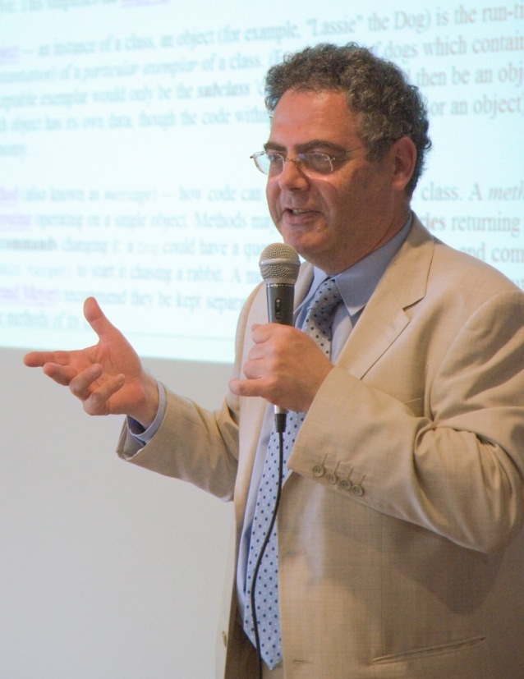
Contracts?
Each program module specifies
What it expects from its users
Precondition
What it ensures to its users
Postcondition
What holds in a stable state
Object invariants

Slide 21
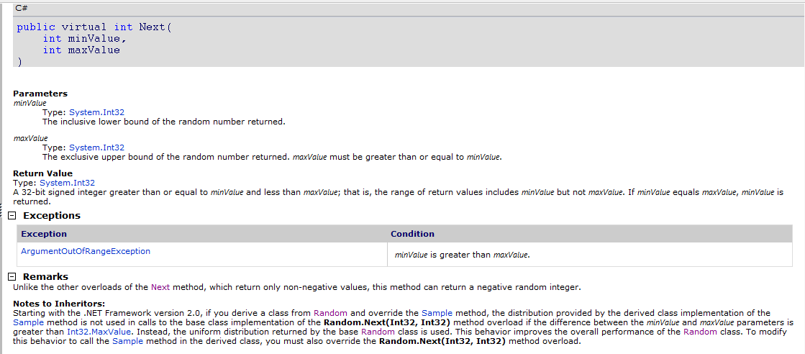
Contracts: What for?
Document design decisions
Precondition
Postcondition

Slide 22
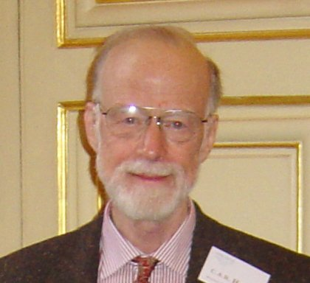
Contracts: What for?
Amplify runtime checking (debugging)
More assertions in the code
More stable the code
Assertions can be disabled
in release builds
Enable modular static analysis
Improved precision
Analysis should not assume worst case
More scalability
A little bit as a type-checker (but more refined!)

Slide 23
Assume/guarantee reasoning
Have methods M, N
M with precondition P, postcondition Q
N call M
If P is true,
then M guarantees Q
When N calls M then
N should establish P
N can rely on Q

Slide 24
But we already have assertions!
All languages have an assert
assert(exp) macro in C/C++
assert exp keyword in Java
Debug.Assert(exp) static method in .NET
Assert is not visible from the caller!
static public int GCD(int x, int y)
{
Debug.Assert(x > 0);
Debug.Assert(y > 0);
}

Slide 25
Exceptions
Use exceptions for parameter validation:
At library surface
To protect from unwanted values
To early detect API misuses
Again, not visible to callers
static public int GCD(int x, int y)
{
if (x < 0)
throw new ArgumentException("Error");
… }

Slide 26
But we have Debug.Assert!
Cannot (easily) specify a postcondition
static public int GCD(int x, int y)
{
Debug.Assert(x > 0);
Debug.Assert(y > 0);
while (true)
if (x < y) { y %= x; if (y == 0) return x; }
else { x %= y; if (x == 0) return y; }
}
Debug.Assert(Result > 0) ?

Slide 27
Assert & OOP : ☹
Inheritance
Precondition: Should be weaker
Postcondition: Should be stronger
How do I enforce it?
Object invariants
Valid in steady states
Ex: this.x != null
Should I add it at every method?
Interfaces, abstract methods
Where I put my assert?

Slide 28
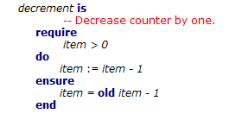
Contracts today
First class citizens in the language
Provide syntax to express contracts
Examples: Eiffel, D, Spec# …
Why not everyone is using it?
New language (start from scratch, or almost)
New compiler (do you trust it?)

Slide 29
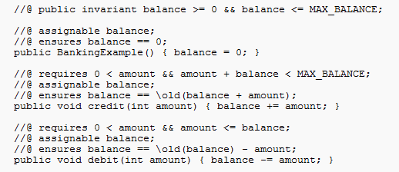
Contracts today
Inside comments or as code annotation
Ex. JML, Eclipse for non-null …
Why not everyone is using it?
Persistence?
Need for serialization, parsing…
Separate type checking, name resolution…

Slide 30
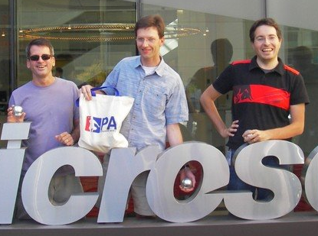
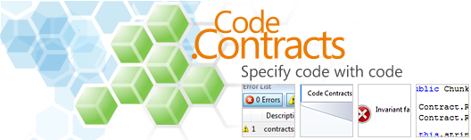
Code contracts

Slide 31
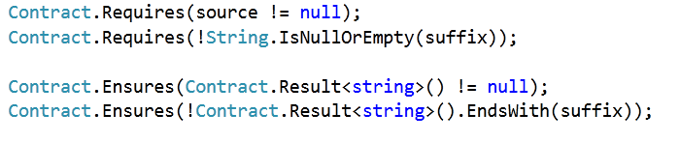

Code Contracts
Idea: Use the IL as contract representation
Use static methods to a contract library
Language agnostic: same for C#, VB, F# …

Slide 32
What are they?
Plain code for contracts
Static methods to a contract library
Language agnostic: same for C#, VB, F# …
Standard from .NET 4.0
No need for a new compiler/language
Precondition: Contract.Requires(...)
Postcondition: Contract.Ensures(…)
Invariant: Contract.Invariant(…)

Slide 33
Preconditions
Contract.Requires(exp)
int foo(String s, int y)
{
Contract.Requires(s != null);
Contract.Requires(y > 0);
// ...
}
C# expressions

Slide 34
Preconditions
Which is the underlying language specification?
Your programming language!!!
Public Function foo(ByVal s As String, ByVal y As Integer)
As Integer
Contract.Requires(s IsNot Nothing)
Contract.Requires(y > 0)
‘ …
End Function
VB expressions
Int32 __gc* foo(String __gc* s, Int32 __gc* y)
{
Contract::Requires(s != 0);
Contract::Requires(y > 0);
C++ expressions

Slide 35
Hmmm…

Slide 36
Side effects?
public class SideEffect
{
int x;
public void foo(SideEffect se)
{
Contract.Requires(XPositive());
//…
}
public bool XPositive()
{
return this.x > 0;
}
public bool XPositive()
{
int oldx = this.x;
this.x = -this.x;
return oldx > 0;
}
Change the state

Slide 37
Purity…
We require the user to add the attribute “Pure”
The user takes the responsibility
No dynamic checking
(it would be too expensive)
Static checking enforced by a separate tool
(I will not talk about it today)

Slide 38
Postconditions
Contract.Ensures(exp)
Class Field
{
int x;
int Set(int y)
{
Contract.Ensures(this.x == y);
this.x = y;
}
}

Slide 39
Result value?
In C#/VB/… no name for the returned value
Use a dummy method
public int Fact(int x)
{
Contract.Ensures(Contract.Result<int>() >= 0); …
}

Slide 40
Question
Why <int> ?
Why <bool[]> ?
public int Fact(int x)
{
Contract.Ensures(Contract.Result<int>() >= 0); …
}
public bool[] ArrayFactory(int x)
{
Contract.Ensures(Contract.Result<bool[]>() != null); return new bool[x];
}
T Contract.Result<T>()

Slide 41
Old value?
No name for the old value
Class Account
{
int balance;
int Add(int k)
{
Contract.Ensures(this.balance == Contract.Old(this.balance) + k);
this.balance += k;
}
}
T Contract.Old<T>(T value)

Slide 42
Quantifiers
Limited form:
Contract.ForAll(0, A.Length, i => A[i] > 0);
Contract.Exists(0, A.Length, i => A[i] > 0);
Exploit higher order functions

Slide 43
Class Invariant
Class Account
{
int balance;
[ContractInvariantMethod]
protected void ObjectInvariant()
{
Contract.Invariant(balance >= 0);
}
}

Slide 44
Interfaces
[ContractClass(typeof(WithdrawContracts))]
interface IWithdraw
{
long Balance { get; }
void Withdraw(long money);
}
[ContractClassFor(typeof(IWithdraw))]
public class WithdrawContracts : IWithdraw {
public long Balance { get { Contract.Ensures(Contract.Result<long>() >= 0); return -111; } }
public void Withdraw(long money) {
Contract.Requires(money < this.Balance);}}

Slide 45
Other
Abstract classes
Similar to interfaces
Out/ref parameters
Use dummy method
Legacy code: “if !exp throw exception”
Use Contract.EndContract()

Slide 46
Why not simply attributes?
(Eclipse does it)
Need Expression serialization
No free type checking
No (almost) free dynamic checking
[ContractPre(“x ≥ 0”)]
protected void foo(int x) { … }

Slide 47
Runtime checking
Achieved with binary rewriting
Handle old, result …
Inherit contracts
Stick contracts to interface implementations

Slide 48
Binary rewriting
public virtual int Add(object value){
Contract.Requires( value != null );
Contract.Ensures( Count == Contract.OldValue(Count) + 1 );
Contract.Ensures( Contract.Result<int>() == Contract.OldValue(Count) );
if (_size == _items.Length) EnsureCapacity(_size+1);
_items[_size] = value;
return _size++;
}
Executable Runtime
Contract Checking
.method public hidebysig newslot virtual instance int32 Add(object 'value') cil managed
{
.locals init (int32 'Contract.Old(Count)',
int32 'Contract.Result<int>()')
ldarg.0
call instance int32 TabDemo.BaseList::get_Count()
stloc.3
ldarg.1
ldnull
ceq
ldc.i4.0
ceq
ldstr "value != null"
call void __RewriterMethods::RewriterRequires$PST06000009(bool, string)
ldarg.0
ldfld int32 TabDemo.BaseList::count
ldarg.0
ldfld object[] TabDemo.BaseList::items
ldlen
conv.i4
ceq
ldc.i4.0
ceq
stloc.1
ldloc.1
brtrue IL_004d
nop
ldarg.0
ldarg.0
ldfld int32 TabDemo.BaseList::count
ldc.i4.1
add
call instance void TabDemo.BaseList::EnsureCapacity(int32)
nop
nop
ldarg.0
ldfld object[] TabDemo.BaseList::items
ldarg.0
ldfld int32 TabDemo.BaseList::count
ldarg.1
stelem.ref
ldarg.0
dup
ldfld int32 TabDemo.BaseList::count
dup
stloc.2
ldc.i4.1
add
stfld int32 TabDemo.BaseList::count
ldloc.2
stloc.0
br IL_0072
ldloc.0
stloc.s 'Contract.Result<int>()'
br IL_007a
ldarg.0
call instance int32 TabDemo.BaseList::get_Count()
ldloc.3
ldc.i4.1
add
ceq
ldstr "Count == Contract.Old(Count) + 1"
call void __RewriterMethods::RewriterEnsures$PST0600000B(bool, string)
ldloc.s 'Contract.Result<int>()'
ldloc.s V_4
ceq
ldstr "Contract.Result<int>() == Contract.Old(Count)"
call void __RewriterMethods::RewriterEnsures$PST0600000B(bool, string)
ldloc.s 'Contract.Result<int>()'
ret
}
csc/vbc/…
Release Compile
/d:CONTRACTS_FULL
.method public hidebysig newslot virtual instance int32 Add(object 'value') cil managed
{
ldarg.1
ldnull
ceq
ldc.i4.0
ceq
call void [Microsoft.Contracts]Microsoft.Contracts.Contract::Requires(bool)
ldarg.0
call instance int32 TabDemo.BaseList::get_Count()
ldarg.0
call instance int32 TabDemo.BaseList::get_Count()
call !!0 [Microsoft.Contracts]Microsoft.Contracts.Contract::Old<int32>(!!0)
ldc.i4.1
add
ceq
call void [Microsoft.Contracts]Microsoft.Contracts.Contract::Ensures(bool)
call !!0 [Microsoft.Contracts]Microsoft.Contracts.Contract::Result<int32>()
ldarg.0
call instance int32 TabDemo.BaseList::get_Count()
call !!0 [Microsoft.Contracts]Microsoft.Contracts.Contract::Old<int32>(!!0)
ceq
call void [Microsoft.Contracts]Microsoft.Contracts.Contract::Ensures(bool)
ldarg.0
ldfld int32 TabDemo.BaseList::count
ldarg.0
ldfld object[] TabDemo.BaseList::items
ldlen
conv.i4
ceq
ldc.i4.0
ceq
stloc.1
ldloc.1
brtrue.s IL_0069
ldarg.0
ldarg.0
ldfld int32 TabDemo.BaseList::count
ldc.i4.1
add
call instance void TabDemo.BaseList::EnsureCapacity(int32)
ldarg.0
ldfld object[] TabDemo.BaseList::items
ldarg.0
ldfld int32 TabDemo.BaseList::count
ldarg.1
stelem.ref
ldarg.0
dup
ldfld int32 TabDemo.BaseList::count
dup
stloc.2
ldc.i4.1
add
stfld int32 TabDemo.BaseList::count
ldloc.2
stloc.0
br.s IL_008b
ldloc.0
ret
} // end of method BaseList::Add
csc/vbc/…
ccrewrite
.method public hidebysig newslot virtual instance int32 Add(object 'value') cil managed
{
ldarg.0
ldfld int32 TabDemo.BaseList::count
ldarg.0
ldfld object[] TabDemo.BaseList::items
ldlen
conv.i4
ceq
ldc.i4.0
ceq
stloc.1
ldloc.1
brtrue.s IL_0029
ldarg.0
ldarg.0
ldfld int32 TabDemo.BaseList::count
ldc.i4.1
add
call instance void TabDemo.BaseList::EnsureCapacity(int32)
ldarg.0
ldfld object[] TabDemo.BaseList::items
ldarg.0
ldfld int32 TabDemo.BaseList::count
ldarg.1
stelem.ref
ldarg.0
dup
ldfld int32 TabDemo.BaseList::count
dup
stloc.2
ldc.i4.1
add
stfld int32 TabDemo.BaseList::count
ldloc.2
stloc.0
br.s IL_004b
ldloc.0
ret
}

Slide 49
Advantages
Produced by all the compilers
Free:
Types
Intellisense
Name resolution…
Cross language
Precise semantics
Uniform format understood by our tools

Slide 50

Static checker (Clousot)

Slide 51


Abstract Interpretation
Theory of approximations
Semantics are order according to the precision
The more the precise the semantics
The more the properties captured
A static analysis is a semantics
Precise enough to capture the properties of interest
Rough enough to be computable

Slide 52
Clousot
Based on Abstract Interpretation
≠ Usual approaches based on theorem prover
Advantages
Automatic
Inference of loop invariants, pre, post, invariants
Predictable
No quantifier instantiation
No easy proofs by contradictory axioms
Scalable
Tune-up for the properties of interest

Slide 53
Algorithm: High level
For each assembly A
For each class C
For each method M
Extract the proof obligations
What should I prove?
Run the analyses
Discover facts on the program
Use the facts to prove the proof obligations
If not, do something else… (next Monday)

Slide 54
Proof obligations
Two kinds: Implicit and explicit
Implicit
NonNull checking
Bounds checking
Divisions by zero, overflow
…
Explicit
Assertions
When calling a method, its precondition
When returning from a method, its postcondition

Slide 55
NonNull dereference
public bool IsCiao(string s)
{
return s.Contains("ciao!");
}
The string s should not be null
Otherwise, exception at run time
Clousot scans the program and records the proof obligation:
s != null

Slide 56
Array bounds
public int[] RandomArray(int len)
{
var random = new Random(len);
var arr = new int[len];
for (var i=0; i < len; i++)
{
arr[i] = random.Next();
}
return arr;
}
Len >= 0
i < arr.Length
i >= 0

Slide 57
Overflows
public int Abs(int x)
{
if (x < 0)
return -x;
return x;
}
public int Div(int x, int y)
{
return x / y;
}
y != 0
x != MinValue
x != MinValue || y != -1

Slide 58
Explicit obligation: Assertions
public string Concat(string p, string q)
{
Contract.Requires(p != null);
Contract.Requires(q != null);
var concat = p + q;
Contract.Assert(concat != null);
Contract.Assert(concat.Length > 0);
return concat;
}
concat != null
concat.Length > 0

Slide 59
Assume/guarantee reasoning
Have methods M, N
M with precondition P, postcondition Q
If P is true, then M guarantees Q
If N calls M then
N should establish P
N can rely on Q

Slide 60
Preconditions
public string Concat(string p, string q)
{
Contract.Requires(p != null);
Contract.Requires(q != null);
// …
}
public string MyConcat()
{
return Concat("Ciao", null);
}
Concat “believes”
(assumes)
those preconditions
“Ciao” != null
null != null

Slide 61
Postconditions
public double Abs(double x)
{
Contract.Ensures(
Contract.Result<double>() >= 0);
if (x < 0)
return -x;
return x;
}
public double Sqrt(double z)
{
return Math.Sqrt(Abs(z));
}
-x >= 0
x >= 0
Sqrt “believes”
(assumes)
Abs(z) >= 0

Slide 62
Read the bytecode

Slide 63
Phase 1
Read the program from the disk
Bytecode format
Bytecode is stack based
Get rid of the stack
Program in 3 addresses form
Build the control flow graph
Get rid of Heap
Scalar program

Slide 64
On the disk…
.Dll or .Exe
Metadata
(attributes?)
Metadata
(bitmaps?)
Code
Class
Method 1 (constructor?)
Method 2
Method 3

Slide 65
.NET
Safe execution environment
Managed execution, GC …
Object-oriented
Shared type system
C#
VB
F#
…
Managed C++
Common Intermediate Language (CIL)
Libraries (mscorlib, System.dll …)
Virtual Machine
Operating System (Windows …)

Slide 66
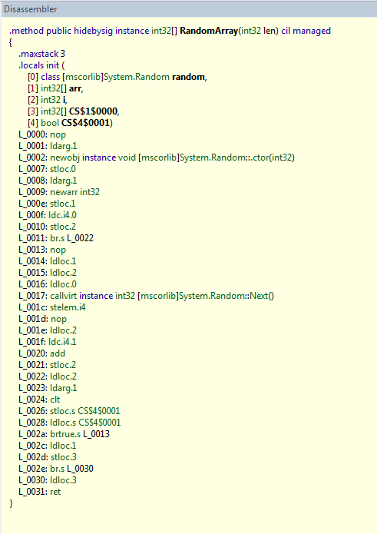
Bytecode
public int[] RandomArray(int len)
{
var random = new Random(len);
var arr = new int[len];
for (var i=0; i < len; i++)
{
arr[i] = random.Next();
}
return arr;
}
C# compiler

Slide 67
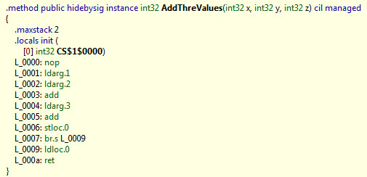
Bytecode is ugly to analyze
public int AddThreValues(int x, int y, int z)
{
return x + y + z;
}

Slide 68
So why we analyze it?
It’s common
Output of C#, F#, VB … compilers
i.e. millions of programmers…
Languages change, bytecode not
C# 2.0 -> C# 3.0 -> C# 4.0
Semantics of bytecode is fix
Closest thing we have to a formal specification
Do not need the source code to analyze

Slide 69
De-stack
Make the stack locations explicit
public int DeStack(int x, int y, int z)
{
int stack; // Stack
int CS_1_0000; // CS$1$0000 is an invalid C# name
stack = x + y;
stack = stack + z;
CS_1_0000 = stack;
return CS_1_0000;
}

Slide 70
De-stack
Syntactic transformation
Input
Stream of instructions for a method
Output
Stream of instructions in one of the forms
R = R1 binop R2
where binop ∈ { +, -, *, /, %, ≥, ≤ > , … }
R = unop R1
Where unop ∈ { -, (int32), (int64) …}
Jump label, ret value
Where jump is { jz, jnz, … }
Call method

Slide 71
Control flow graph construction
Method entry
assume Pre(f)
entry
entry

Slide 72
Control flow graph construction
Method exit
assert Post(f)
ret v
ret v

Slide 73
Control flow graph construction
Method call
assert Pre(f)
Call f()
Call f()
assume Post(f)

Slide 74

Control flow graph construction
Jumps
jump l
istr 1
…
istr n
jump j
l:
istr n+1
…
istr k
j:
istr 1
…
istr n
l:
istr n+1
…
istr k
j: …
A sequence of non-jump instructions is a block

Slide 75
De-Heap
Variables can alias
public class Alias
{
int x;
public void Foo(bool b)
{
Alias tmp = new Alias();
tmp.x = -11;
Alias alias = tmp;
if(b)
{
alias.x = 10;
}
Contract.Assert(tmp.x == -11);
}
}
alias and tmp alias!
Is it true?

Slide 76
De-heap
Goal:
Remove the heap
Assign a name to each heap location
Input:
A program in 3 addresses form
Output:
A program without explicit heap locations
All variables are assigned at least once (SSA)
Idea:
Track equalities

Slide 77
An example
public class Alias
{
int x;
public void Foo(bool b)
{
Alias tmp = new Alias();
tmp.x = -11;
Alias alias = tmp;
if(b)
{
alias.x = 10;
}
Contract.Assert(tmp.x == -11);
}
}
public class AliasScalar
{
public void Foo(bool b)
{
int svX = -11;
if (b)
{
svX = 10;
}
Contract.Assert(svX == -11);
}
}
Use e-graph
At the blackboard

Slide 78
That’s all for today

Slide 79
Let’s recap
We’ve seen:
Contracts
Documentation
Better debugging
Assume/guarantee reasoning on the code
Clousot
Collect proof obligations
Implicit/explicit
Bytecode analysis
De-Stack
CFG construction
De-Heap

Slide 80
Next
Expression recovery
Numerical abstract domains in Clousot
Pentagons
Combination of domains
Subpolyhedra
Hints
Floating points
Backward analysis
Inter-method inference
Message prioritization and filtering

Slide 81
Ciao!

